Slide 1



Lesson 2: HTML
<Web />
Front-end
Development
University of Tehran
Lecturer:
Misagh Mohaghegh
ACM
Summer of Code 2024

Slide 2
A Short Review…
Course Certificate (4 class absence, 70% homework)
Prerequisites (programming, VSCode, Git, GitHub)
UI/UX Designer vs Front-end Developer
Web Page Building Blocks (HTML, CSS, JS)
JS Frameworks
Schedule (HTML, CSS, Bootstrap, JS, React, API)
HTTP Protocol (URL, client-server model)
HTTP Request (GET, POST, PUT, DELETE methods)
HTTP Response (3-digit status codes)

Slide 3

Please ask your questions!
Ask any questions you have in the telegram Q&A topic.
Ask any question in the class time too!
Ask your questions from Google and AIs as well.

Slide 4
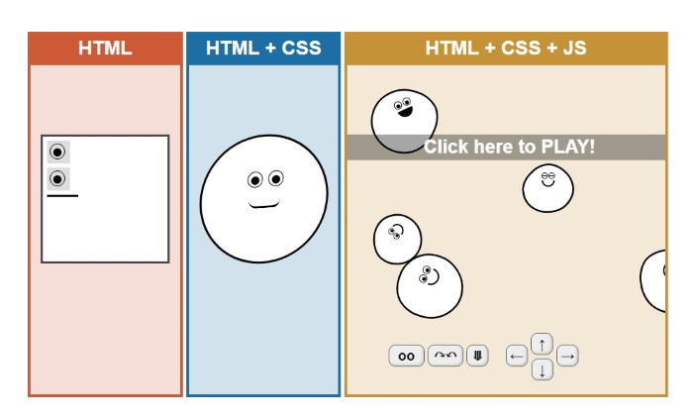
Time for…

Slide 5

Hypertext Markup Language

Slide 6
HTML Basics

Slide 7
Hypertext Markup Language
The most basic building block of the web.
Hypertext: links that jump to other places in the document (like this).
Markup Language: a text system to specify the structure, formatting and presentation of a document.
Version History: (W3C recommendation)
HTML 1.0 (1993): Initial version, basic structural elements and hyperlinks.
HTML 2.0 (1995): Standardized, forms and tables.
HTML 3.2 (1997): Basic styling, feature enhancements.
HTML 4.01 (1999): CSS support, new tags.
HTML5 (2014): Semantic tags, multimedia tags.

Slide 8
HTML Elements
HTML elements are made of tags, attributes, and their content.
Tags are placed between two angle brackets: <tagname>
Opening Tag
Closing Tag
<p>This is a text</p>
Content
Element

Slide 9
Nested Elements
The opening and closing order of the tags matter.
<p>This is a <i>short</i> text</p>
<ul>
<li>list item one</li>
<li>list item <b>two</b></li>
</ul>

Slide 10
Void Elements
Void elements do not need a closing tag.
<br>
<br />
<hr>
<hr />
Creates a line break.
Creates a horizontal rule.

Slide 11
Attributes
Attributes contain extra information about our element that doesn't appear in the content.
They are key-value pairs written inside the opening tag of an element.
<p id="bottom-note" class="editor-note">Example paragraph text</p>
Attribute key="value"
<img src="images/picture.png" alt="My sample image">
<img src="images/picture.png" alt="My sample image" />
<input type="text" name="username">

Slide 12
Comments
To insert comments in our HTML code:
<!-- This is a comment! -->
<h1>Level 1 heading here</h1>

Slide 13
XHTML
XML (Extensible Markup Language)
XHTML (Extensible HyperText Markup Language)
There are some differences between them.
XHTML is less lenient than HTML:
All elements must be closed (even void elements).
Tag and attribute names are case-sensitive.
Attribute minimization not allowed.
<br> <!-- invalid -->
HTML: <img> = <Img> <!-- not in XHTML -->
<option selected> => <option selected="selected">

Slide 14
Global Attributes
Global attributes are some specific attributes that can appear on all elements.
Such as:
id: sets a unique identifier for the element.
class: space-separated list of CSS class names. These can be reused.
dir: sets the direction of text for the element and its children. Can be "ltr" or "rtl".
lang: sets the language for the content of the element, e.g. "en".
title: set extra information for an element (appears on hover).
hidden: marks the element as semantically hidden and does not display it.
data-*: custom user-defined attributes.
style: set inline CSS style for the element.
<p id="unique-name" class="class-name another-one" data-my-key="value"
dir="rtl" lang="en" title="World Wide Web Consortium" hidden>
W3C – Welcome!
</p>

Slide 15
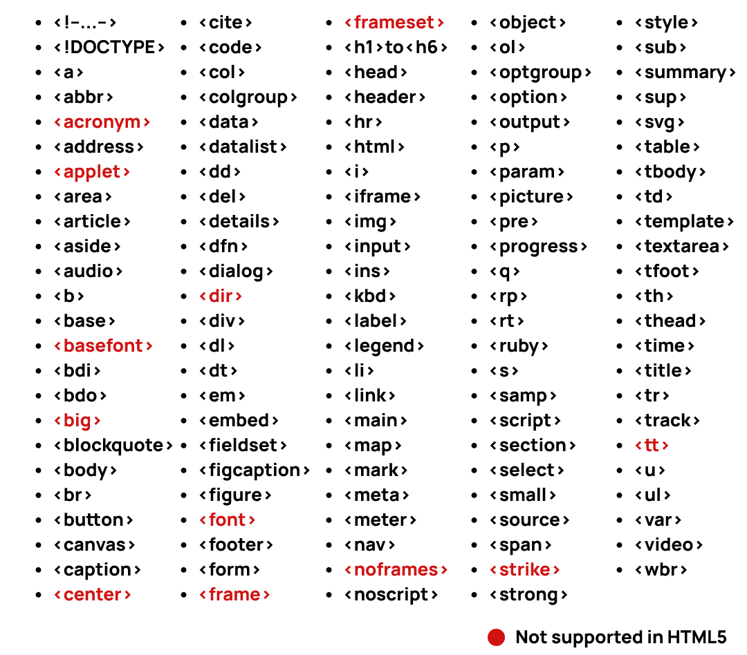
So Many Tags!

Slide 16
Construction of an HTML Page

Slide 17
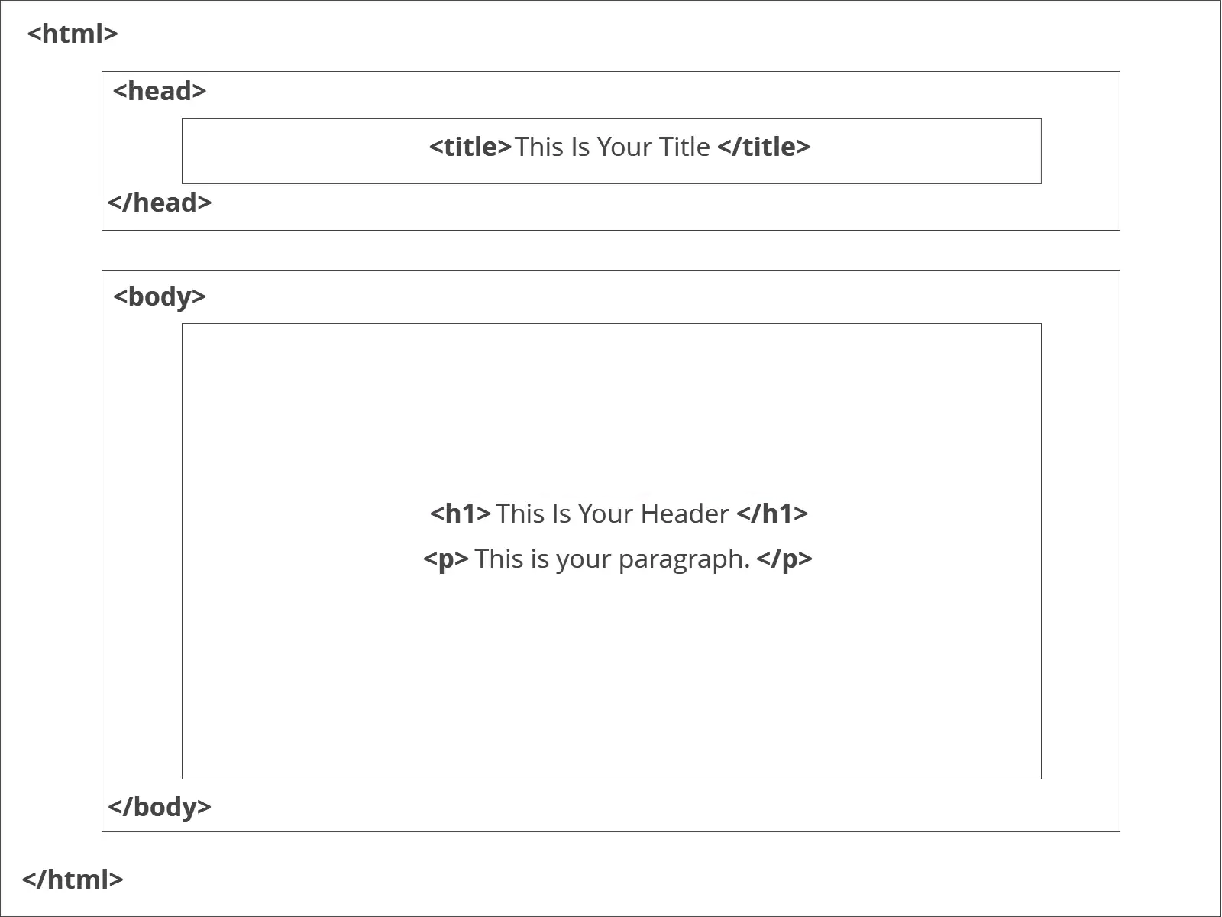
Anatomy

Slide 18
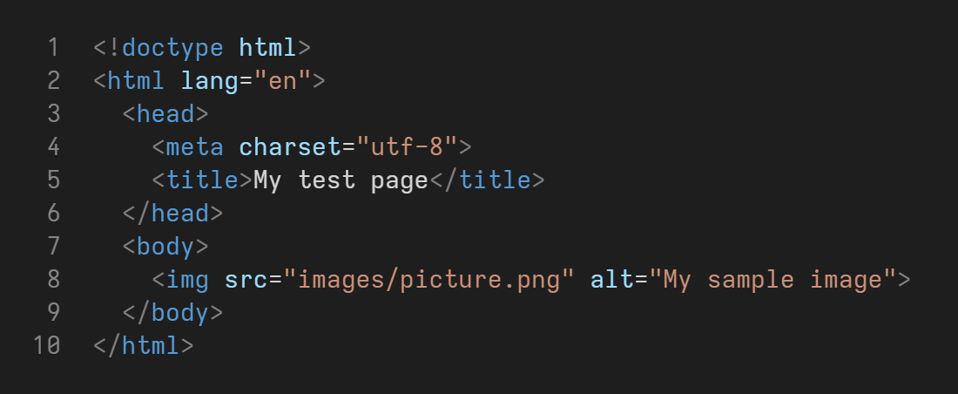
Anatomy

Slide 19
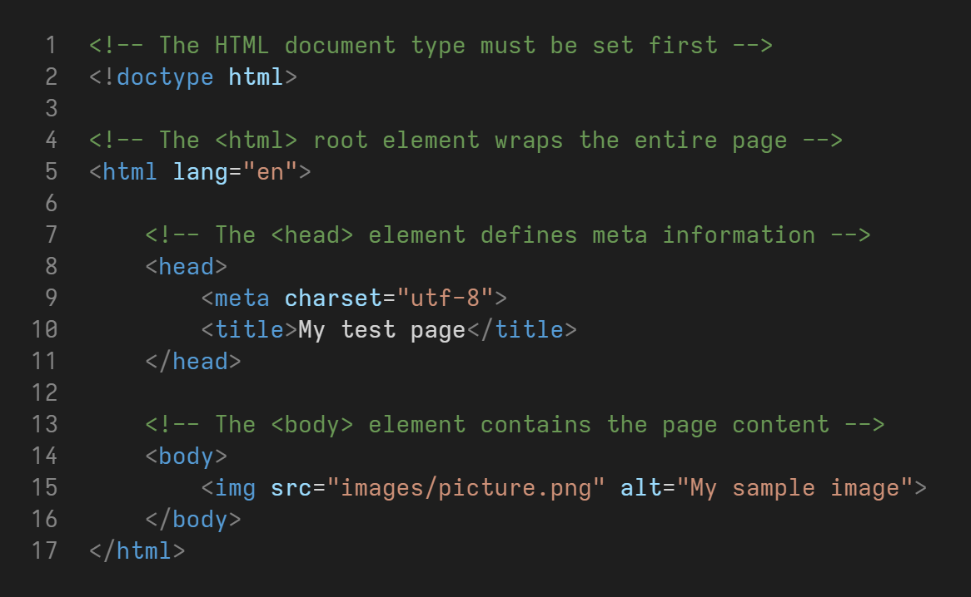
Anatomy

Slide 20
<html>
First of all, the <!doctype html> line must be written.
The html tag typically has the lang attribute.
The head element contains page metadata.
The body element contains page content.
Remember to close the tags.
<!doctype html>
<html lang="en">
<head>
...
</head>
<body>
...
</body>
</html>

Slide 21
Metadata
Here is a list of tags that can be put in the head element:
<title>: the page name at the top of the browser.
<link>: mostly for linking CSS files and favicon.
<style>: writing CSS styles.
<script>: writing JS code.
<meta>: defining metadata:
Character set:
Keywords:
Description:
Author:
Auto Refresh:
Viewport:
<title>My Page Title</title>
<link rel="stylesheet" type="text/css" href="file.css">
<link rel="icon" type="image/x-icon" href="file.ico">
<meta charset="utf-8">
<meta name="keywords" content="HTML, CSS, JS">
<meta name="description" content="Front-end Course">
<meta name="author" content="Misagh Mohaghegh">
<meta http-equiv="refresh" content="60">
<meta name="viewport" content="with=device-width, initial-scale=1.0">

Slide 22
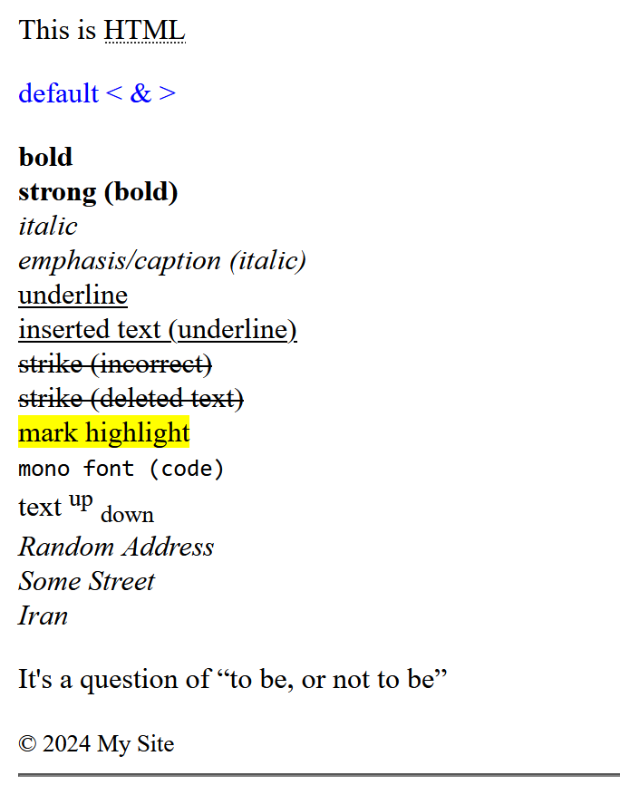
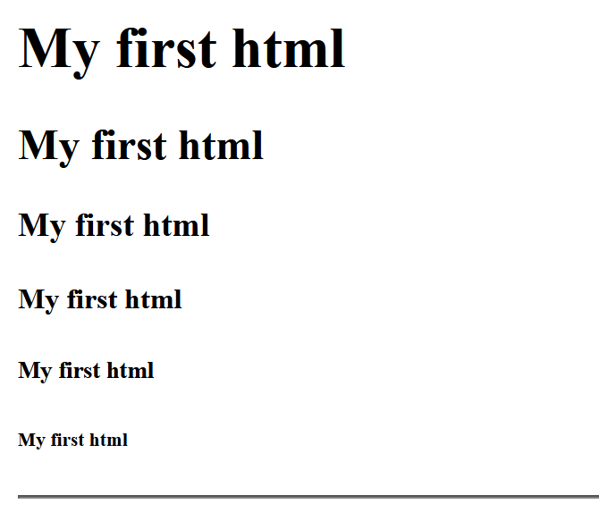
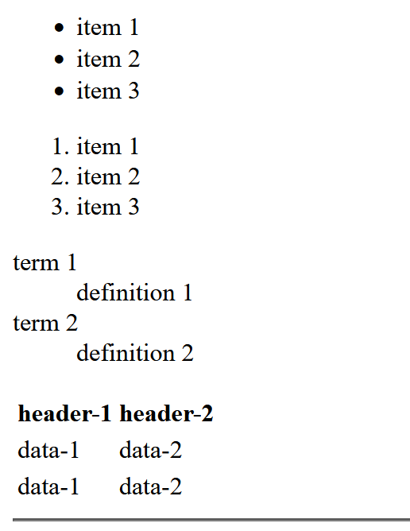
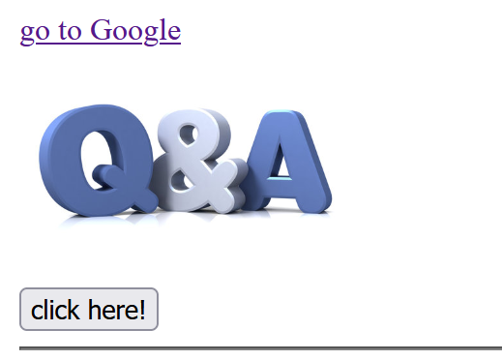
Body
Lets check out the most useful HTML tags in code!

Slide 23
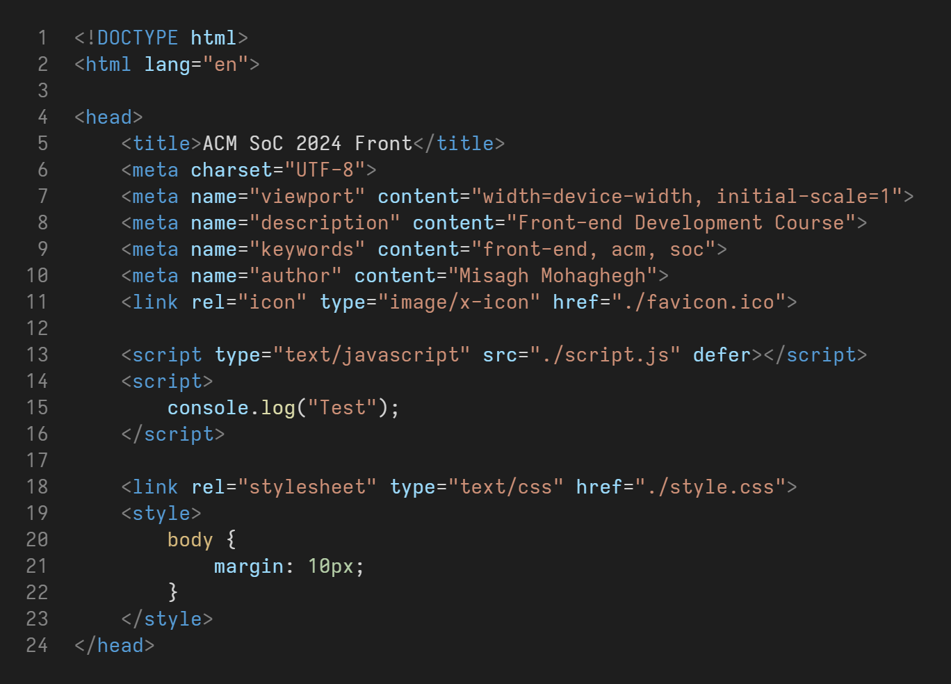
Body

Slide 24
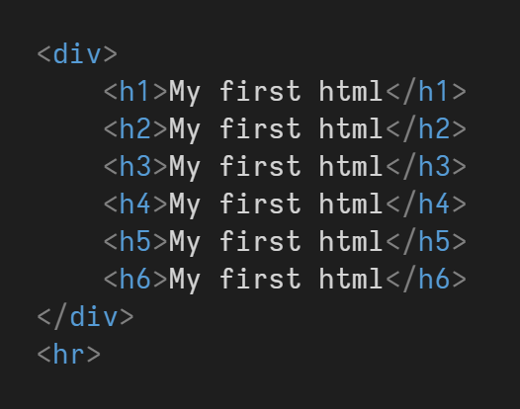
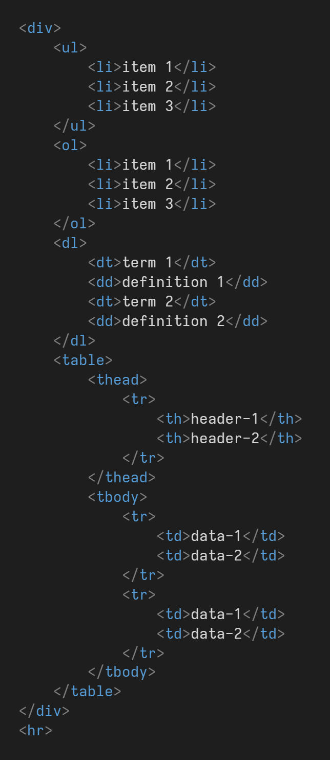
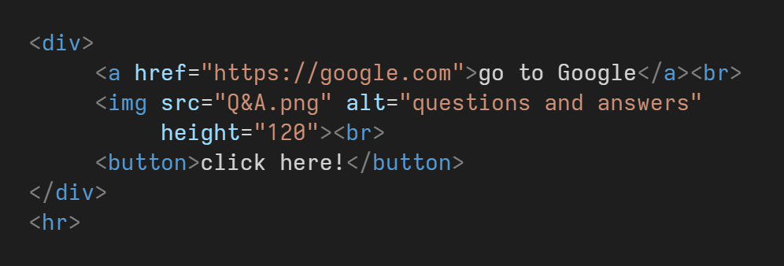
Body

Slide 25
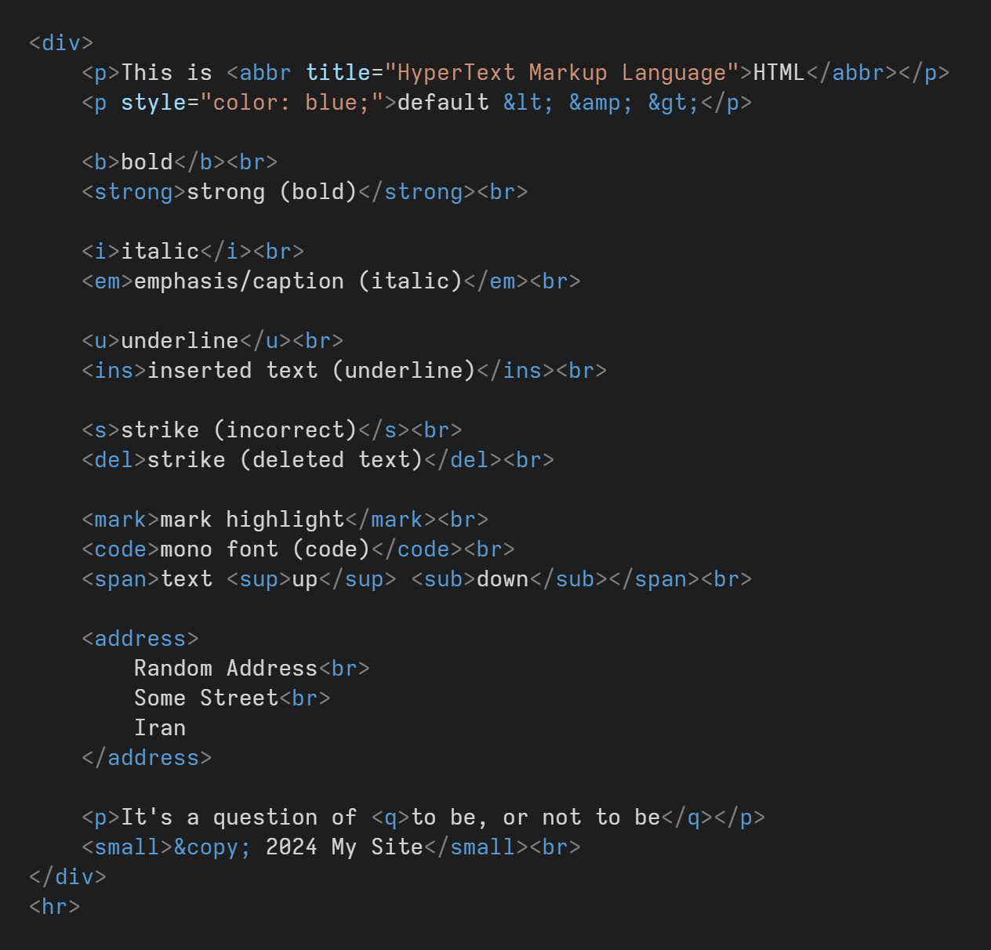
Body

Slide 26
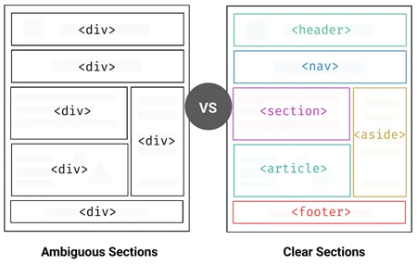
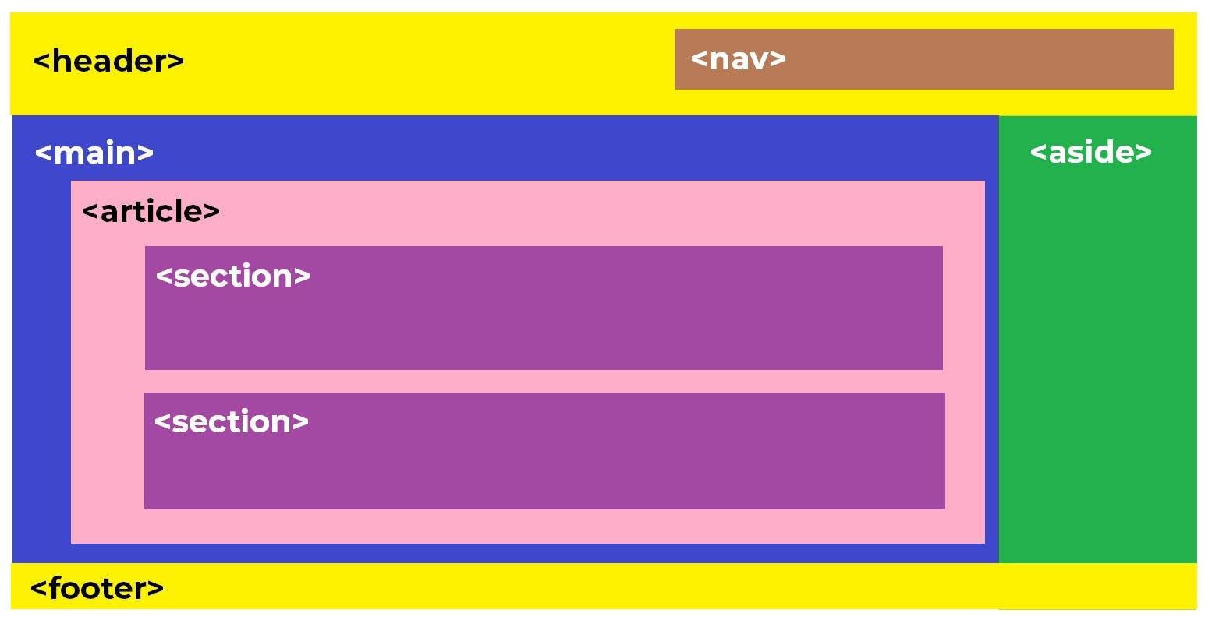
Semantic Tags
The <div> tag is used to create divisions and group sections of a web page together like a container.
But there are tags that do the same thing but have more meaning.

Slide 27
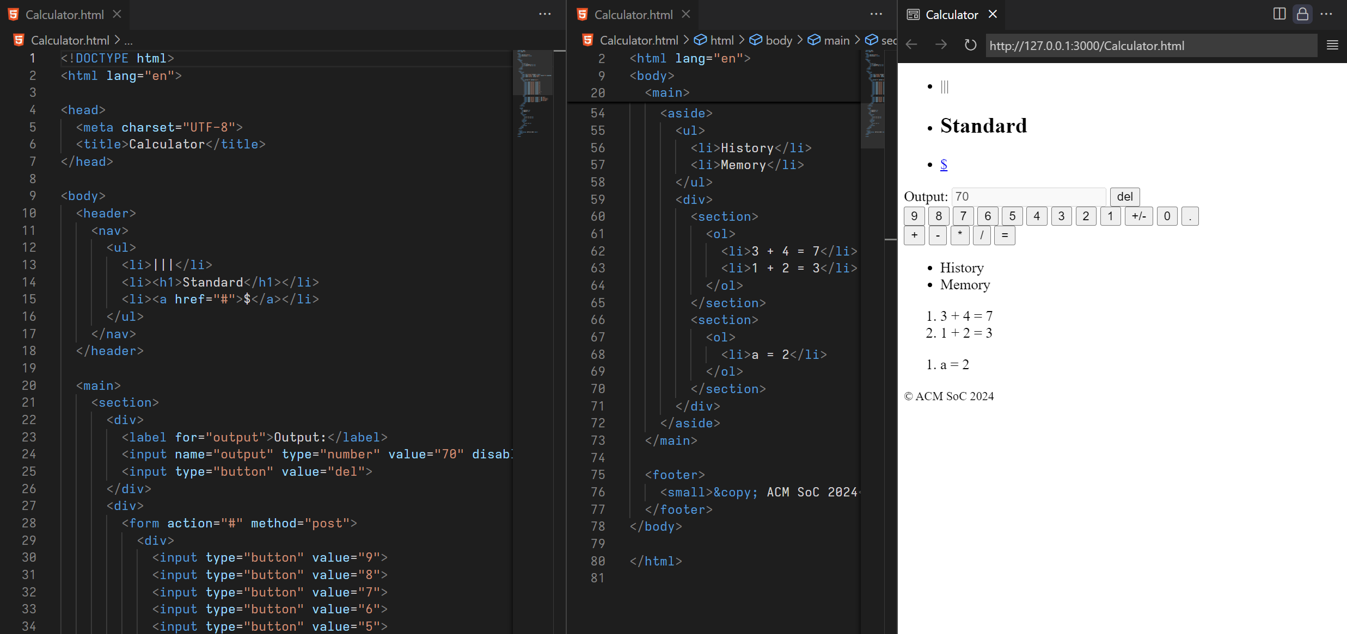
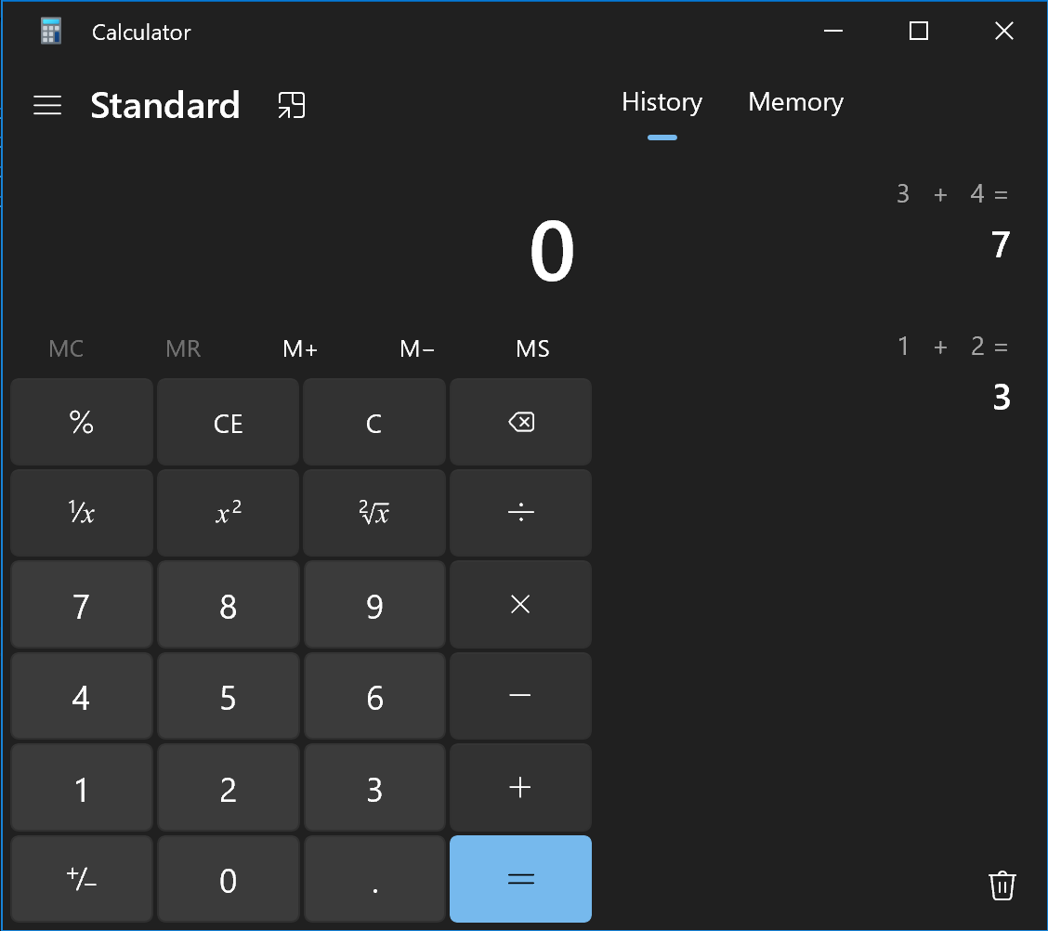
Calculator Example

Slide 28
Forms & Inputs

Slide 29
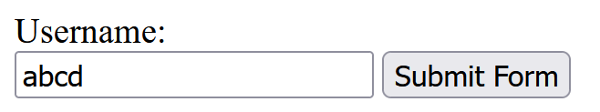

Forms
HTML forms are used to collect user input. This is usually sent to a server for processing.
First of all, a <form> element is created.
There can be any element nested inside of it, but mostly <label> and <input> elements are used.
Other input elements include: <select> & <option>, <textarea>, and <button>.
<form method="get" action="/somepage">
<label for="username">Username:</label><br>
<input type="text" id="username" name="uname">
<input type="submit" value="Submit Form">
</form>

Slide 30
Labels
There are two ways to assign labels to an input:
<label for="username">Username:</label><br>
<input type="text" id="username" name="uname">
<label>
Username:<br>
<input type="text" name="uname">
</label>
Inputs are optional by default. To mandate users to fill the input, use the required attribute:
<input type="text" name="uname" required>

Slide 31
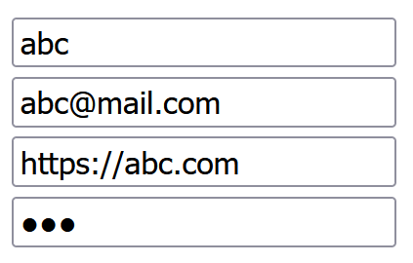
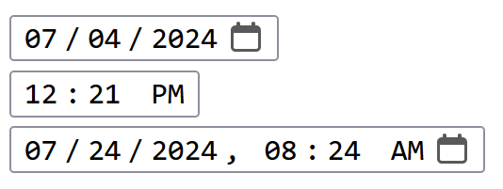
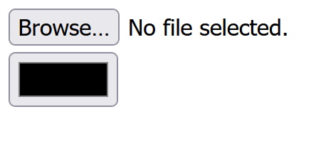
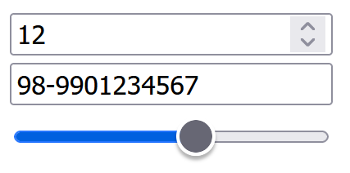
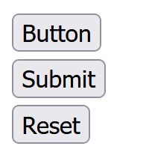
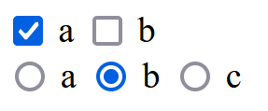
Input Types
There are many input types:
<input type="text">
<input type="email">
<input type="url">
<input type="password">
<input type="number">
<input type="tel">
<input type="range">
<input type="checkbox">
<input type="radio">
<input type="date">
<input type="time">
<input type="datetime-local">
<input type="file">
<input type="color">
<input type="hidden">
<input type="button">
<input type="submit">
<input type="reset">

Slide 32
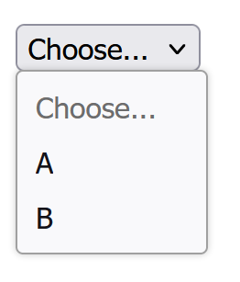
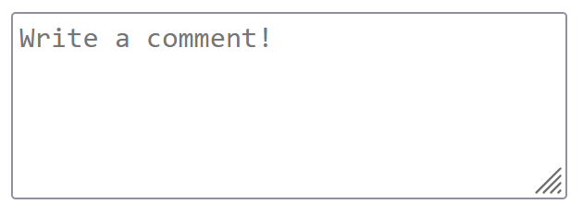
More Inputs
Other input types not a part of the <input> element:
<select name="key">
<option value="" disabled selected>Choose...</option>
<option value="a">A</option>
<option value="b">B</option>
</select>
<textarea name="comment" rows="5" cols="32"
placeholder="Write a comment!"></textarea>

Slide 33
Thank you for your attention.

